Slide 1


Slide 2
METHANE
(CH₄)

Slide 3
This is commonly known as firedamp though, technically, a CH₄ -air mixture is sometimes referred to as firedamp.
There are three primary reasons for giving particular attention to methane.
First, it is the naturally occurring gas that most commonly appears in mined underground openings.
Secondly, it has resulted in more explosions and related loss of life than any other cause throughout the recorded history of mining.
The third reason for giving special attention to CH₄ concerns the continued development of methane drainage technology.

Slide 4
Formation of Methane
CH₄ is formed in the coalification process of plant materials through biochemical decay and metamorphic transformation.
CH₄ is a product of decay of cellulose (C₆H₁₀O₅)^{n} and is formed whenever vegetable matter such as timber decomposes under water and out of contact with air, as in marshes. Hence it is also called marsh gas.
Since it is produced by bacterial and chemical action on organic material, it is evolved during the formation of both coal and petroleum.
It forms part of coal seams and associated strata as coal has been formed million years ago in that manner.
The CH₄ content of coal seams increases with depth.
CH₄ is emitted not only in coal mines but is also found in rock salt, potash and clay mines.

Slide 5
CH₄ is retained within fractures, voids and pores in the rock either as a compressed gas or adsorbed on mineral (particularly carbon) surfaces.
When the strata is pierced by boreholes or mined openings, the gas pressure gradient that is created induces migration of the methane towards those openings through natural or mining-induced fracture patterns.
The gas content of a coal bed is made of two parts –
  free gas compressed in pore spaces of the coal and
  the gas absorbed in the internal surface of the coal.
The proportion of free gas in the coal pores depends on the porosity of the coal seam, gas pressure and temperature. It usually accounts for a small portion 5 to 10% of the total gas content of the seam.
The greater part of CH₄ is held in situ on the surfaces of the coal pores and microfaractures in adsorbed form.
Since the internal surface area of coal can be as large as 90 m²/g, the quantity of adsorbed gas can be extremely high.

Slide 6
Properties of Methane
It is a colourless, odourless and tasteless gas.
Although CH₄ itself has no odour, it is often accompanied by traces of heavier hydrocarbon gases in the paraffin series that do have a characteristic oily smell.
CH₄ is lighter than air (Sp. gr. 0.554).
It has a density of 0.7168 kg/m³ and is 0.554 times as heavy as air. Due to this it tends to rise to the roof of a mine working and forms pools or layers along the roofs and in rise workings of underground openings.
CH₄ is not toxic but is particularly dangerous because it is flammable and can form an explosive mixture with air.
It is combustible but does not support combustion.
CH₄ burns in air with a pale blue flame.

Slide 7
In an abundant supply of air, the gas burns to produce water vapour and CO₂.
CH₄ + 2O₂ →2H₂O + CO₂
Within the confines of mine openings and during fires or explosions, there may be insufficient O₂ to sustain full combustion, leading to formation of the highly poisonous CO.
2CH₄ + 3O₂ → 4H₂ O + 2CO

Slide 8
When mixed with air it forms an explosive mixture, the limits of explosibility being 5 and 15% by volume.
The gas is not poisonous but suffocates a person due to lack of O₂ if present in large quantities.
It is hardly soluble in water, 100 vols. of water at 20 °C dissolving only 3.3 vols. of CH₄.

Slide 9
Limits of Flammability, Flammable Limits, or Explosive Limits of Methane
The flammable limits of CH₄-air mixtures are the limits of concentration of CH₄ in air between which a flame can be propagated throughout the mixtures.
The boundary-line mixtures with minimum and maximum concentration of CH₄ in air, which if ignited, will just propagate flame are known as the lower and upper flammable or explosive limits.
- The lowest % of CH₄ in air that yields an inflammable mixture is called the lower flammable limit (LFL).
- The highest % of CH₄ in air that yields a similar mixture is called the upper flammable limit (UFL).

Slide 10
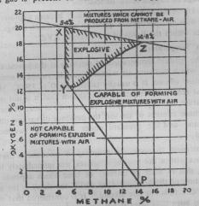
Coward’s Diagram

Slide 11
It shows the limits of explosibility with different percentages of firedamp and oxygen. The important points to note are:
All mixtures lying within the triangular area XYZ, are in themselves explosive.
All mixtures lying to the right of PYZ contain too much methane to explode, but they will form explosive mixtures when mixed with the right amount of air.
All mixtures lying to the left of PYX are neither explosive, nor capable of forming explosive mixtures with air.
Lower limit of explosibility remains almost constant at about 5.4% for all percentages of oxygen down to about 12.5%.
The higher limit of explosibility gradually decreases from 14.8% to about 6% with decreasing percentage of oxygen.
No percentage of firedamp is explosive when the percentage of oxygen is 12 or less.
A firedamp-air mixture may become explosive when diluted with an appropriate quantity of air which brings the new mixture within the limits of the triangle XYZ.

Slide 12
Measurement of methane content of coal seam
The main objective of determining the gas content of virgin coal beds is to forecast the expected methane levels in mine air of the prospective mine in the same coal seams.
Methane content of coal is defined as the vol. (m³) of gas in unit mass (t) of virgin coal under natural conditions.
It depends on
  The degree of coalification or rank of coal: higher rank coals containing more methane.
  Depth of the seam and
  Duration of denudation cycle

Slide 13
Graham found the gas content of small lumps of coal to range from 0.36 to 16.8 m³/t.
Russian work shows that gas content of coal ranges upto 30-40 m³/t, occasionally rising to 50-60 m³/t in vary porous and fissured coals.

Slide 14
Methods of estimation of gas content of coal seams
All these methods can be grouped into two categories:
1. Direct methods and
2. Indirect methods

Slide 15
Direct method of measurement of methane content
The most commonly used direct method was developed by USBM and hence called US Bureau of Mines’ method.
It consists of
  obtaining a core sample from the seam by drilling and enclosing it as soon as possible in a bomb (sample container) and
  measuring the gas released with time.
It is preferable to take a full length of the core since variations in gas content of the coal seam can occur due to the variability in the quality of coal.

Slide 16
Sample core is put in the sample container and the lead of the container is sealed and the valve is opened.
Readings of the volume emitted are started as soon as the coal sample is placed in the container.
The volume of the gas emitted is continuously recorded at every 15 min for the next several hours until the gas emitted from the sample is less than 0.05 cm³/g per day for 5 consecutive days.
The most convenient way to measure methane emission from the sample container is the water displacement method in which the water of the inverted graduated cylinder is displaced by the methane gas released from the sample core.

Slide 17
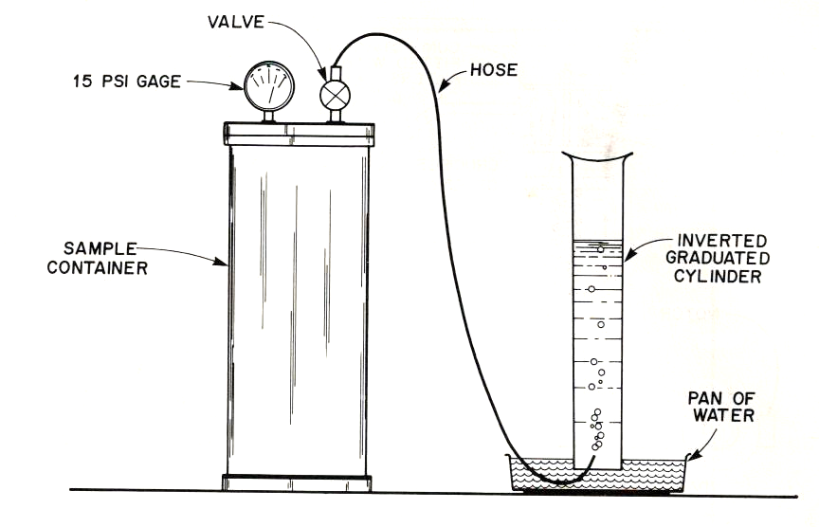
Fig. Sample container
(Gas is measured by displacement of water)

Slide 18
After desorption is completed or virtually completed, the core is taken out of the bomb and its mass is determined.
Then the core is crushed to at least 200 mesh in a sealed bomb using steel rods or steel balls and the gas released during crushing is measured.

Slide 19
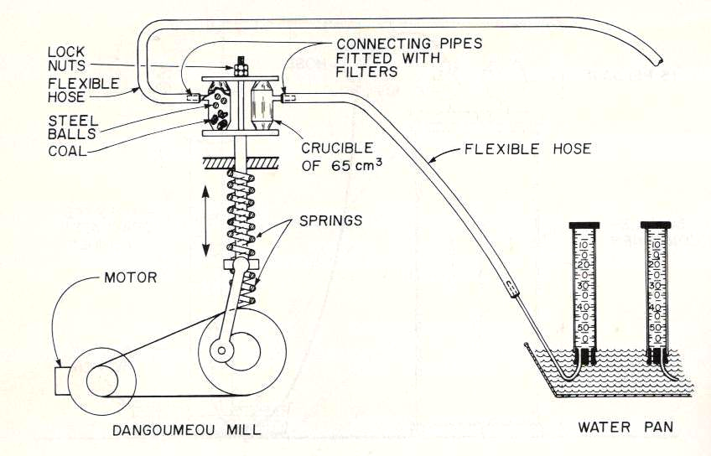
Fig. Gas content determined by crushing coal sample

Slide 20
The total gas content of the core Q is obtained using the relationship
Q = Q1 + Q2 +Q3
Q1 = gas lost during the time of core is being removed from the borehole and placed in the sample container
Q2 = gas liberated from the core while in the sample container
Q3 = gas liberated when the coal sample is crushed, commonly called the rest gas.

Slide 21
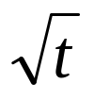
Calculation of lost gas
In estimating the amount of gas lost, lost time t has to be established accurately.
The quantity of lost gas can be determined theoretically by calculation.
A graphical technique which is more accurate and rapid can also be applied.
The vol. of gas first given off from the sample container is plotted against to calculate gas lost during the transfer of the sample from seam to bomb.
Where t = lost time

Slide 22
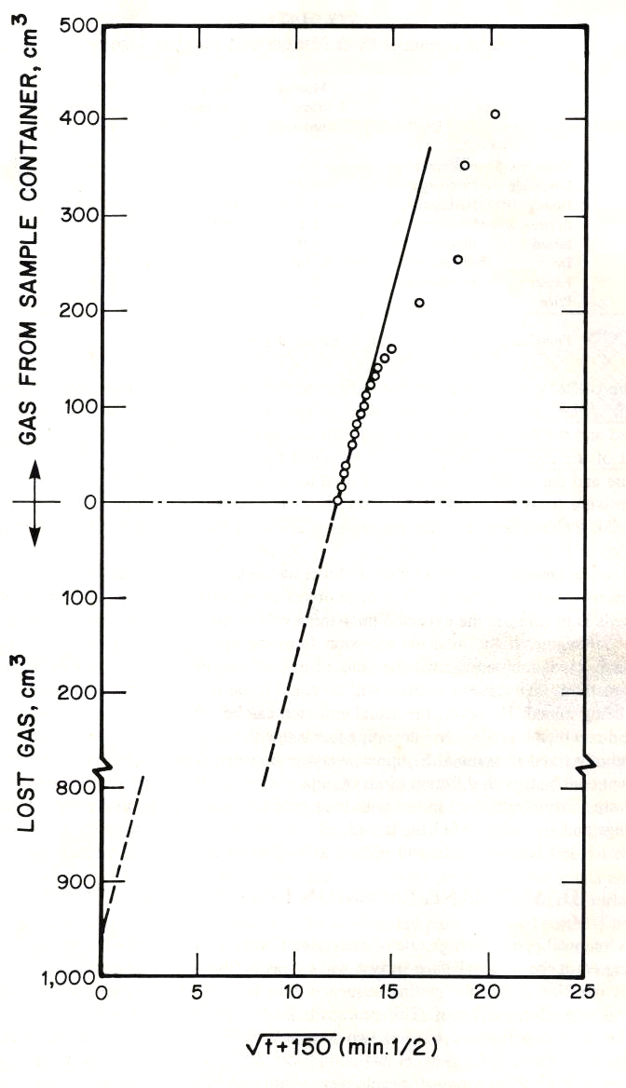
Fig. Emission rate curve

Slide 23
If θ is the time measured from the instant coal is inserted in the sample container and
Time elapsed between this instant and coring of coal is 150 min.
Then t = θ + 150.
By extrapolating the linear portion of the graph back to θ = 0, the lost gas is obtained.
Some investigators believe that determination of lost gas is not essential because of the overall inaccuracy of the system and take the lost gas equal to 10% of (Q2 + Q3)

Slide 24
Indirect method of measurement of methane content
An indirect method is sometimes used to estimate the methane content in virgin coal beds.
In indirect method, as per USBM measurements, a vertical borehole is drilled into the virgin coal seam from the surface.
The shut-in pressure in boreholes drilled into coal is measured which is correlated with the methane content.

Slide 25
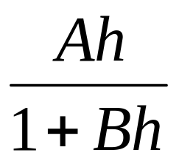
They developed an empirical correlation between the depth of hole and the gas content in the form
V =
Where
V = vol. of adsorbed gas
h = depth of hole
A and B are constants

Slide 26
Emission of methane
In coal mine, methane may find its way in the workings in the following ways:
Gradual exudation or bleeding from the coal and adjacent strata in the roof and floor.
In the form of blowers: Can be felt on the hand and may in some cases be heard.
In the form of gas outburst: May sometimes associated with violence.
Release by roof fall or sudden fall of barometric pressure which may force the gases of the goaf into the workings.

Slide 27
Gradual exudation of methane
CH₄ is emitted chiefly by a process of slow exudation from the seam and adjacent strata when fresh surfaces of coal and other CH₄-bearing formation are exposed during the process of working.
Pulverization of coal during cutting, loading, transportation etc. causes desorption of methane.
The size of coal produced has a great influence on the amount of gas emitted at the face.
While large lumps release only 2% of their total gas content in the 1st ten minutes, coals of 0.25-1 mm size release 40% and of < 0.25 mm size, 66%.
However, it is the exposed coal surface after mining produces the major part (50-75%) of the gas rather than the mined coal.

Slide 28
Gas blowers
Gas is emitted from strata in the form of continuous blowers or feeders, sometimes at a fairly high pressure, for few minutes to several years.
A gas blower is a powerful irruption of gas in the form of jets from cracks or coal faces.
It is accompanied by hissing or roaring sound which can be heard over a long distance in the calm of an underground mine.
Blowers are usually met in areas which have been faulted or folded.
The gas from a blower is generally pure CH₄.
Gas emission from a blower is usually heavy in the initial stages and gradually goes down till it is finally exhausted.
Gas from permanent blowers can be coursed to the surface and utilized for scientific or industrial purposes, for power generation, lighting or heating.

Slide 29
A well known example of a blower was in a British coal mine of Garwood.
The blower of very long duration was met in a sinking pit and the gas was led to the surface and burnt for nine years in a flare so high that the flame could be seen some 15 km away.
Another example of a gas blower of very long duration is that of Cymmer Colliery in South Wales (UK) which has been feeding gas, 97.5% methane at a rate of 25 m3/hr for over 70 years.
In coal seams which are prone to gas blowers underground roadways should be advanced with advanced exploratory boreholes using special drilling machines.
The effective way of dealing with blowers in a mine is
  to seal the area off,
  blocking or closing the crack from which the blower emanates and
  coursing the gas of blower to the surface by special pipes.
However, the ventilation of the district has to be improved to keep the percentage of gas in the general body of the return air within permissible limit.

Slide 30
Gas outbursts
Sometimes, methane may be given out from the strata in violent outbursts which emit large volumes of gas in a short time along with a lot of small coal and fine dust.
They are accompanied by a blast of gas and fog.
Outbursts generally occur in the vicinity of areas of geological disturbance owing to the sudden release of confined gas in the disturbed zone as the confining pressure is released by a working approaching the area.
It occurs from adjoining strata where gas has been trapped as no permeable channel existed for the release of the gas.
High stress combined with high gassiness of a seam induces an instantaneous outburst.
Coal is projected violently from the face and disintegrates, releasing the gas.

Slide 31
The face can be flooded with fine broken coal, a large amount of gas and coal dust.
The projected coal may cause violence.
Such outbursts have occurred with differing severity in Australia, Belgium, Canada, Japan, Poland, USSR, Turkey and south Africa.
The outburst that occurred at the Valleyfield Colliery, UK in 1911 caused the advance of a level by three meters throwing out about 90 tonnes of small coal and killing three men.
In a Belgian mine more than 120 persons were killed due to outburst of CH4 liberating 3,39,800 m³ gas.
The gas outburst can be prevented by
  proper mine planning,
  conducting premining methane drainage and
  adopting stress relief techniques.

Slide 32
METHANE LAYERING

Slide 33
Because of low density, methane has a tendency for streaming particularly in steeply dipping roadways.
When methane is emitted at the roof, travels up the dip in a layer near the roof depending on the velocity of air-current and the roughness of the roof.
With turbulent airflow and a rough roof with obstructions such as roof bars etc. the tendency to streaming is reduced.
If the air-current travels down the dip, it breaks up streaming and carries the methane down the dip.
The critical velocity for breaking up of streaming in smooth roadways depends on the dip and varies from 0.04 m/s for a slope of 1 in 100 to 1.45 m/s for a slope of 1 in 2.8.
The tendency for streaming is greater with an up-the-dip air velocity where the critical velocity becomes higher.
Evidence of a no. of gas explosions showed that they were caused by the ignition of these layers.

Slide 34
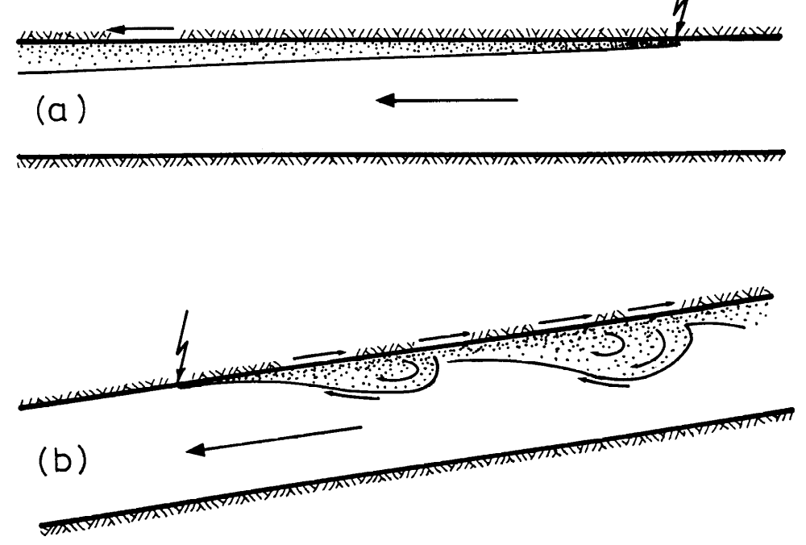
Fig. Methane layering in (a) a level airway
(b) A descentionally ventilated airway

Slide 35
Stable CH4 layers can also develop at the roof of horizontal airways depending chiefly on
Rate of gas emission, particularly at the roof
Size of the airway,
Velocity of air and
  Layering of CH4 occurs when ventilation is insufficient to readily disperse the gas into the air current.
  In large airways with relatively low average air velocity, there occurs at the roof a laminar boundary sublayer of sufficient thickness.
  Any CH4 emitted into this boundary sublayer cannot get diluted by turbulent diffusion and hence forms into a layer sometimes up to 1 m thickness which moves in the direction of the air-current at a slower velocity.

Slide 36
Other factors affecting methane layering are
  roughness of the airway surface,
  presence of bends, obstructions etc. nearby and
  nature and location of the sources of CH4 emission.

Slide 37
The conc. of CH4 in the layer gradually decreases from the top downwards with almost pure CH4 occurring against the roof.
In one case it was nearly 38% gas accumulated at the roof level but its conc. was only 1% at 0.3 m below the roof.
The edge of a layer: defined as the point where the conc. is a certain fraction of the conc. at the roof.
The thickness: defined as the perpendicular distance between the roof and the edge of the layer.

Slide 38
The Layering Number (L)
In general, layering of methane depends on
  velocity of the ventilating air stream, (m/s)
  rate of gas emission, (m3/s)
  width of airway (m)
  inclination of airway
  relative densities of the air and gas
  surface roughness of the roof above the layer (smooth or rough)
  type of ventilation (ascensional or descensional),
A methane layer can be described by combining all these factors into one number, called the layering number (L)

Slide 39
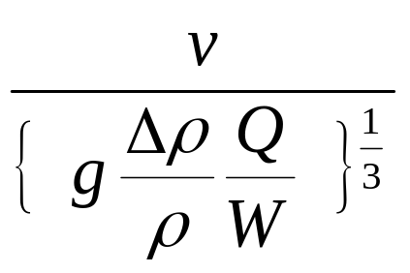
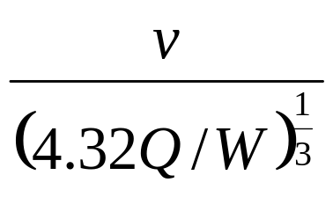
The stability of methane layers as well as their length is indicated by the dimensionless layering number.
Bakke and Leach found that the characteristic behaviour of a gas layer was proportional to the dimensionless group.
L = =
Where
Δρ = density difference of air and methane
ρ = density of air
v = average velocity of air, m/s
Q = quantity of methane emitted into the roadway, m3/s
W = width of airway, m
The constant 4.32 is the product of g and the density difference between air and methane to the density of air.

Slide 40
It is obvious that CH4 layering depends much more strongly on the air velocity than on make of gas.
Layering no. exceeding 2 in a horizontal airway causes turbulent diffusion and breaks up the CH4 layer. However a layer of sufficient length still forms.
Length of the layer is the distance from the source to the point where the mean conc. of CH4 in the layer is 5%.
The layer shortens rapidly as the air velocity continues to increase giving Layering Numbers over 1.5.
Based on the results, it may be recommended that in level airways, Layering Numbers should not be less than 5.
Generally, there is a sharp decrease in the length of the layer with an increase in the layering number > 5 and hence it should be taken as a desirable value.
In inclined airways the desirable layering number depends on the direction of air-flow.
For ascensional ventilation, the desirable layering no. is around 8 and for descensional ventilation, it is less than that for horizontal airways.

Slide 41
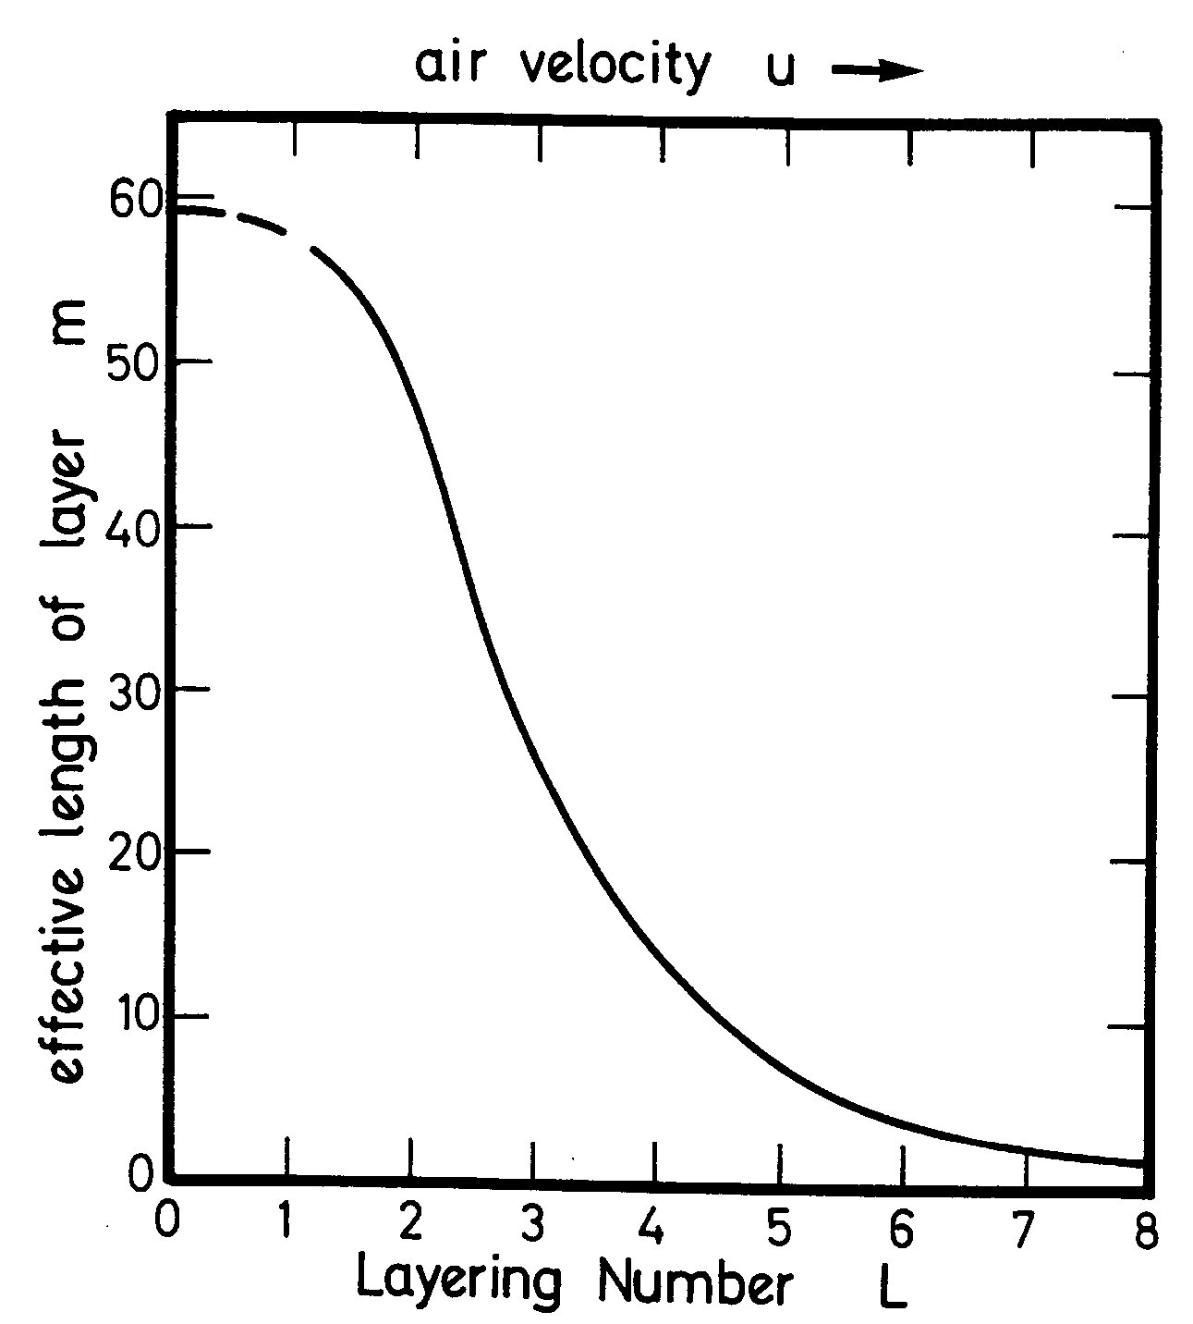
Fig. Variation of layer length with layering number for level airways

Slide 42
Prevention and remedial measures / Dealing with methane layering
Problem of methane layering becomes important in highly gassy coal mines particularly where large sized and duplicate airways cause reduction in air velocity.
Such layers pose a constant explosion hazard and have to suitably dealt with.
The methods to deal with layering are as follows:
One practical method to deal with layering is to increase the velocity of ventilating air current.
In addition to that other remedial measures are as follows:
Placing vertical or inclined hurdle sheets across the airway a little below the roof: helps in diverting the main air-current to the roof and breaks up the layer.

Slide 43
Using venturi blowers: for breaking up methane layers, where compressed air supply is available.
  Small 100 mm dia. venturi blowers fed by 3 mm jets of compressed air is sufficiently powerful to break up layers as much as 70m length.
By conducting methane drainage: to reduce the gas emission from the strata and minimize the occurrence of CH4 layering.
Controlling rate of gas emission: by a suitable selection of mining method, length of face, rate of face advance, type of mechanization, method of ground control etc.
Prior working of an adjacent less-gassy seam: helps in reducing the rate of gas emission.
Infusion of the seam ahead of the face with water or foam: has been used for sealing the pores in coal and preventing gas migration to the face.

Slide 44
METHANE DRAINAGE

Slide 45
The surest way of bringing down the rate of CH4 emission in highly gassy seams is by methane drainage.
Apart from minimizing the hazards, it often yields valuable quantities of CH4 which can be used as fuel.
Methane is a reach source of fuel.
One kg of CH4 in burning evolves 13,600 kcal of heat, whereas, 1 kg gunpowder releases only 580 kcal and 1kg of nitroglycerine gives out 1500 kcal.
CH4 has successfully drained from coal from coal seams in many countries and utilized for industrial as well as household purposes.

Slide 46
It is considered wise to adopt methane drainage in all seams with a gas emission exceeding 20-25 m³/t.
Methane drainage was 1st tried in a colliery of the Ruhr Coalfields, Germany in 1943 and since then it has been successfully adopted in foreign countries.
In India it is experimented at Amlabad Colliery and some more gassy seams are being evaluated for the purpose.
The reason for not trying in a large scale in India is that our mines are not very deep and not very gassy.
Degasification during methane drainage can be conducted from
1. the seam being worked, or
2. the seam above or below the seam being worked, depending upon accessibility.

Slide 47
Methane drainage of neighboring seams is the technique commonly adopted.
The aim is to place one or more boreholes into the strata which are presumed to be a natural reservoir of gas by reason of their porosity or contact with carbonaceous mater like coal or carbonaceous shales.
The boreholes are 45 to 60 degree off vertical leaning towards the in bye, 37 to 75 mm in dia and 20 to 60 m apart.
Holes are drilled from the intake or return airway until the upper seams are intersected.
Hole lengths of 80m are not uncommon. Long boreholes yield generally gas with higher CH4 content.
All the holes are equipped with water separators and devices for measuring the pressure and quantity of gas flowing.
The gas is removed from the boreholes by suction using rotary vacuum pumps installed on the surface.

Slide 48
Methods of CH4 drainage
There is no single preferred technique of methane drainage.
The major parameters that influence the choice of method include
  the natural or induced permeability of the source seam(s) and associated strata
  the reason for draining the gas
  the method of mining (if any).
The common methods being practiced for CH4 drainage are
  In-seam drainage
  Gob drainage by surface boreholes
  Cross-measure borehole method
  Superjacent heading method or Hirschbach method and
  Pack-cavity method.

Slide 49
In-seam drainage
Methane flow into mine workings can be reduced significantly by pre-draining the seam to be worked.
In-seam drainage is successful only if permeability of coal is high.
Boreholes may be drilled to lengths of 1000 m within the seam using down-the-hole motors and steering mechanisms.

Slide 50
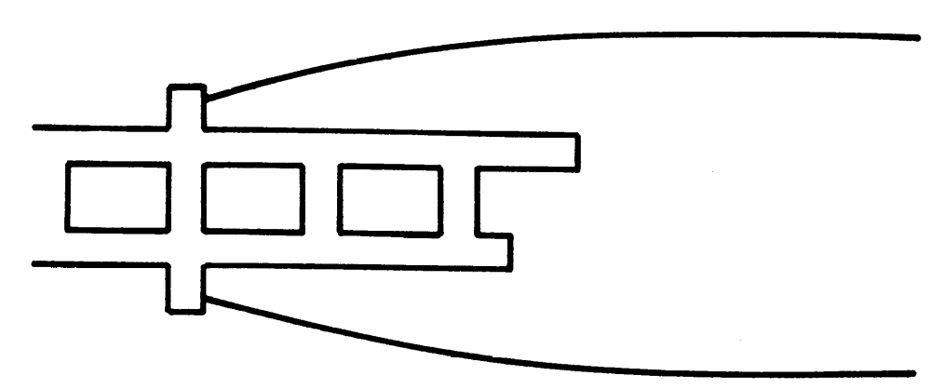
Fig. In-seam drainage boreholes to reduce methane flow into advancing headings
Flanking boreholes used to drain gas from the coal ahead of headings that are advancing into a virgin area.

Slide 51
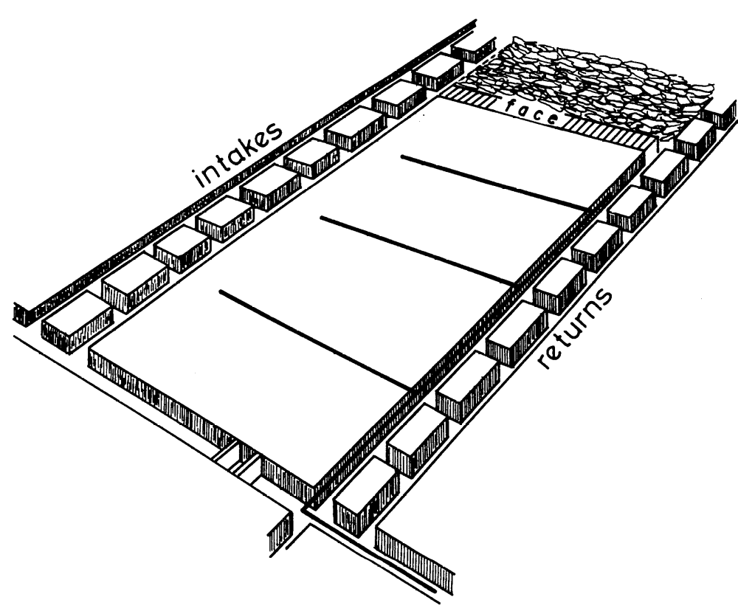
In-seam gas drainage can also be effective in permeable seams that are worked by the retreating longwall systems as shown in Figure.

Slide 52
Boreholes are drilled into the seam from the return airway and connected into the methane drainage pipe system.
Preferred spacing of the holes depends upon the permeability of the seam and may vary from 10 to over 80 m.
The distance from the end of each borehole and the opposite airway should be about half the spacing between holes.
Application of suction on the boreholes may be required for coals of marginal permeability or to increase the zone of influence of each borehole.
Time allowed for drainage should be at least 6 months and, preferably, over 1 year.
Hence, the holes should be drilled during the development of the tailgate of the longwall.

Slide 53
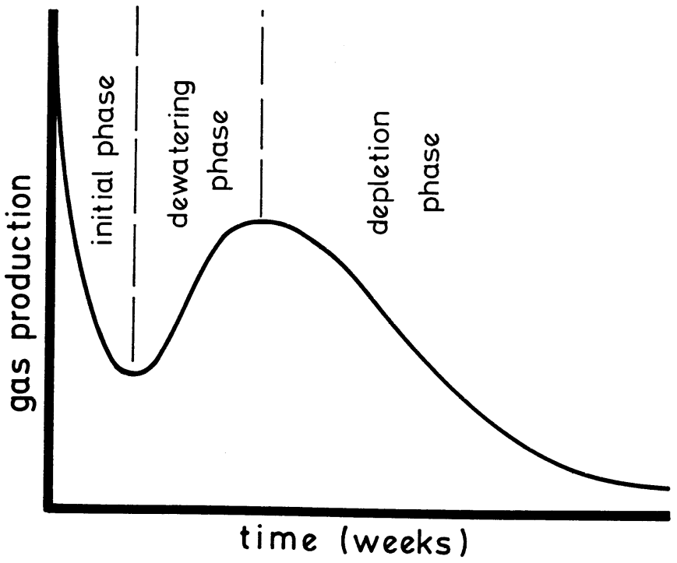
The flow rate of gas from a gas drainage borehole varies with time.
Initially high flow occurs due to expansion and desorption of gas in the immediate vicinity of the hole which may diminish fairly rapidly.
As the zone of influence is dewatered, the relative permeability of the coal to gas increases and hence increases the gas flow.
This is again followed by a decay as the zone of influence is depleted of gas.
Figure: A typical life cycle of gas drainage from an in-seam borehole.

Slide 54
Gob drainage by surface boreholes
Methane accumulates at high conc. in the voids or goaves of the longwall panel and called ‘gob gas’.
If this gas is not removed, then it will migrate towards the working horizon and become a load on the ventilation system of the mine.
Capture of this "gob gas" is accomplished underground either by cross-measures drainage or by drilling vertical boreholes from the surface.
This is method is favoured in the United States.

Slide 55
Fig. Gob drainage of a longwall panel

Slide 56
Typically, 3 or 4 holes are drilled from surface rigs at intervals of 500 to 600 m along the centreline of the panel and ahead of the coal face.
The holes may be 200-250 mm in dia. and drilled to within 8-10 m of the top of the coal seam .
The holes should be cased from the surface to a depth that is dictated by the local geology.
A perforated liner can be employed in the rest of the hole to inhibit closure from lateral shear.
The initial gas made from the surface holes is likely to be small.
However, as the face passes under each borehole, the CH4 that accumulates in the caved area will be drawn towards that borehole.

Slide 57
Bed separation assists drainage from the complete gob area.
The first borehole should be located far enough from the face start line (typically about 150 m) to ensure that it connects into the caved zone.
When a hole becomes active, the rate of gas production increases sharply and may yield over 50,000 m3/day of commercial quality CH4 for a period of several months, depending upon the rate of mining.
Gas drainage pumps located on surface ensure that the gas flow remains in the correct direction and may be employed to control both the rate of flow and gas purity.
If the applied suction is too great, then ventilating air will be drawn into the gob and may cause excessive dilution of the drained methane.
In addition to longwall panels, gob drainage by surface boreholes can be utilized in pillar extraction areas.
This technique can result in very significant reductions in emissions of methane into mine workings.

Slide 58
  Cross-measure borehole method
It is the most common method used for methane drainage.
Cross-measure boreholes are drilled from roadways (usually tail gate of an advancing longwall face) either upwards or downwards in a working seam.
Upward holes are more common because methane usually accumulates in the bed-separation cavities in the roof of the seam and is driven out of these cavities as the roof breaks and collapse.
The holes are inclined depending on the dip of the strata.
In flat seams the inclination is generally at an angle of 50-60° from the horizontal over the waste.
An inclination less than 45° produces less gas, causes greater dilution of the gas (because of the larger leakage of air into the hole) and increases the chances of jamming of the bore-rods in the hole.
Sometimes good results have been claimed with holes inclined towards the face.

Slide 59
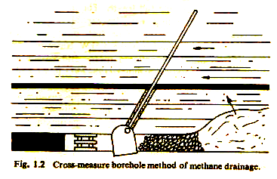

Slide 60
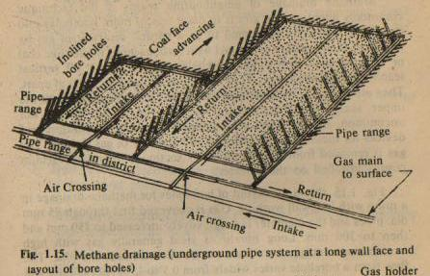

Slide 61
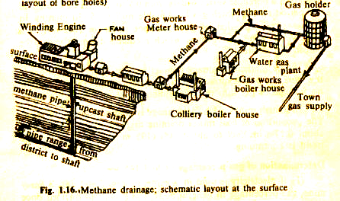

Slide 62
Normally boreholes are placed in the return airway, since
  the ventilating pressure drives the gas in the goaf towards the return airway.
  the haulage in the intake makes it difficult for the bulky drill to operate due to lack of space.
Boreholes are usually 65-90 mm in dia. and spaced at intervals of 20-30 m along the road so that they are not too close to each other to be very costly nor they are too far apart for adequate drainage.
Their length varies from 15 to 100 m (commonly 35-40 m) depending upon the adjacent gas-bearing seams which have to be intersected for drainage.
Holes are started off with a dia. of 115 mm and collar pipes 10m long and 90 mm in dia. are connected to them before they are drilled to the full length.

Slide 63
The holes for CH4 drainage need special drilling machines capable of drilling long holes of large diameter cheaply.
One such machine which found suitable is the 4.5 kW Nusse and Graffer Fortschritt PIV/6 pneumatic-powered rotary drill having a rotational speed of 125 to 250 rpm and using multi-point fir-tree type of bits.
Usually the rate of gas emission rises for the first two weeks until a maximum is reached at a distance of 30 to 300 m from the face, after which the rate of emission falls.
Usually a suction pressure of 1000 to 1500 Pa is used to drain the gas.
Suction should be high enough to overcome the friction of the pipe ranges, but, at the same time, should not be so high that air may leak into the goaf and dilute the methane.
Advantages of cross-measure borehole method :
CH4 discharged into the ventilation system is decreased by 50-60% or sometimes more due to this method.
Of all the methods, this method is the simplest and cheapest, but yields less gas than Hirschbach method.

Slide 64
Superjacent or Hirschbach Method
This method is applicable where an unworkable seam exists some 25 to 35 m above the seam being worked.
In this method, headings with cross-sectional area of 5-7 m² are driven at a height of about 25-30 m on top of the working seam.
They are so positioned that their vertical projections lie midway between the gate roads in the working seams.
It is better to locate the drive in a coal seam at least 0.3-0.4 m in thickness if such a seam is available. Otherwise, they may be driven in stone.
For economy, an already existing drift or one driven for some other purpose may be chosen for methane drainage.
Both along-the-seam and cross-measure boreholes are drilled from these headings.
The headings are sealed at the outbye end by dams through which pipes are left.
Methane is drawn from the headings through these pipes by applying a suction of 203 kPa.

Slide 65
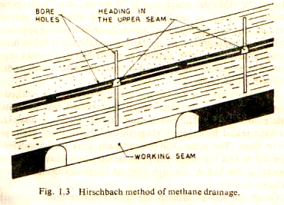

Slide 66
This method is prevalent in mines in Eastern Europe and China.
Advantages and disadvantages of Hirschbach method
This method yields maximum quantity of gas with a high methane percentage.
The driving and drilling operations are done outside the working seam and hence do not interfere with normal mining operations.
For retreating longwall and bord-and-pillar workings, Hirschbach method is the only suitable method.
This method is not very successful when the seam being worked has a massive sandstone cap because enough roof fissures are not developed with such a roof and as a result the gas flows more easily to the face than to the drainage drift.

Slide 67
Pack-cavity method
In this method corridors or webs parallel to the face are left in solid pack at intervals of about 40 m and within 20 m from the intake-and-return-gate roads.
Individual pack cavities are connected to a main pipe range of 150-300 mm in dia. in the return airway through pressure gauges, orifice type flow meters, water drain taps, sampling taps and valves etc.
The gas is collected by applying a suction head of 250 to 350 Pa.

Slide 68
Disadvantages:
This method yields minimum quantity of gas which is often much diluted.
In this method, only a closely controlled small suction head can be applied to prevent air leakage into the goaf causing
  spontaneous heating and
  dilution of the gas drained.

Slide 69
DETECTION OF METHANE

Slide 70
Many firedamp detectors utilizes various physical properties of Methane-air mixture e.g.:
Density
Refractive Index
Thermal conductivity
Inflammability
Change of volume of combustion
Diffusion
Absorption of infra-red rays etc.

Slide 71
Methods of Detection of Firedamp
Detection by Flame Safety Lamp
Detection by using Methanometer

Slide 72
Methanometers:
Two types:
Automatic types: Gives a signal when the gas % reaches a certain predetermined value
2. Estimating types

Slide 73
MSA D6 Methanometer
Principle of Working
Based on the principle of Wheatstone Bridge which utilizes the change in resistance of a wire on heating by combustion of CH4

Slide 74
Constructional Features:
A balanced Wheatstone Bridge circuit
A sensitive galvanometer and
A battery

Slide 75
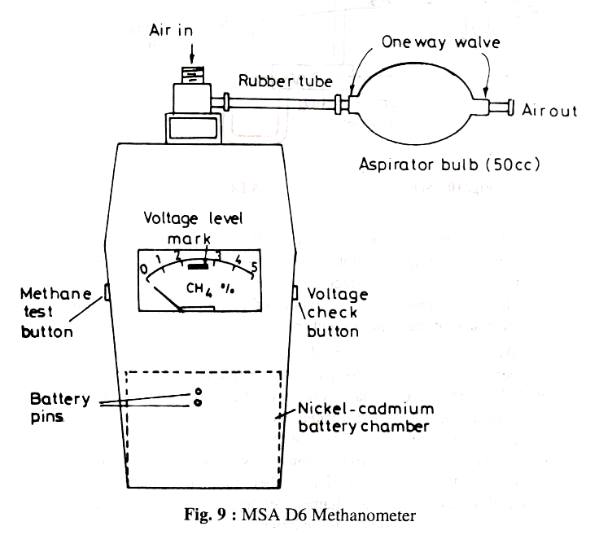

Slide 76
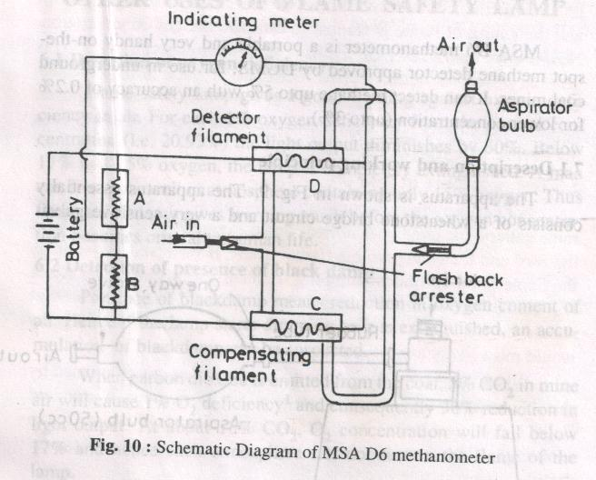

Slide 77
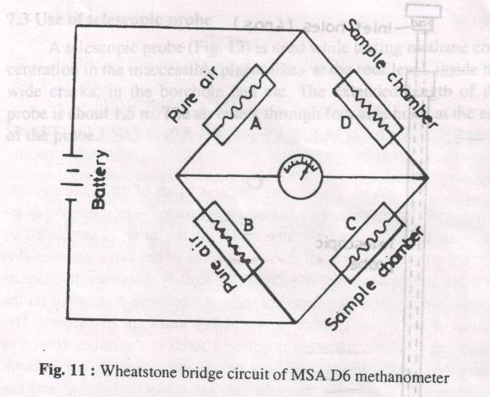

Slide 78
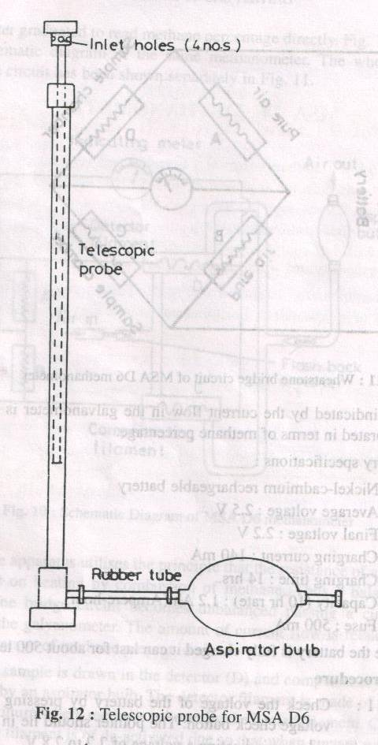

Slide 79
SAMPLING AND ANALYSIS OF MINE AIR

Slide 80
Sampling of Mine Air
Collection of Mine Air Samples
Spot samples: Collected at predetermined places in mine airways for routine analysis
Where variation in composition is expected over the cross-section of the airway: inlet of the sample holder may be traversed over the section of the airway in a regular fashion
Where distinct variation in composition exists: as in CH4 layering, spot samples at several intervals have to be taken at the airway cross-section

Slide 81
Methods of air sample collection:
Water or salt-solution displacement:
  Air samples are collected by emptying out the liquid contained in the sample holder.
  Water displacement is unsuitable when CO2 is to be accurately determined since CO2 is readily soluble in water.
  A 22% aqueous solution of common salt is suitable for this case.
Air displacement: by sucking through mouth or by aspiration through a rubber aspirator or a hand or foot-operated pump.
In evacuated sample holders: in the form of glass bulbs evacuated by vacuum pump.

Slide 82
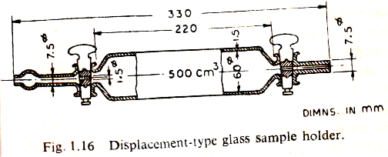
Sample holders
Gas samples holders both displacement and vacuum type are generally of 250-500 cm3 capacity.
Glass: is the most suitable material for sample holder.
It is fragile and needs careful handling

Slide 83
Metallic holders:
Stop valves tend to leak if not properly fitted and greased
Iron and tin are unsuitable as they readily absorb O2 in the sample
Brass and other non-ferrous metals can be used but if H2S and NO2 are present, copper and its alloys become unsuitable.
Rubber or polythene: should not be used as gases diffuse through them

Slide 84
Quantity of air samples needed for analysis
For analysis in the Haldane Apparatus:
  requires very small quantity and only 70 cm3 is enough for 3 analysis
For analysis in the Orsat Apparatus:
  250-500 cm3 is needed

Slide 85
Analysis of Mine Air
By mine air analysis, normally conc. of gases like O2, CO2, CO, CH4 and N2 which are the common constituents of mine air are determined.
Rare constituents like H2S, SO2 and NO2 are estimated by accurate spot detectors.

Slide 86
Methods of Analysis
Chemical Analysis:
Accurate and cheaper method
Time consuming
Requires large amount of gas samples
Common Chemical gas-analysis Apparatus
Orsat Apparatus
Haldane Apparatus: requires small samples

Slide 87
Physical Methods of Analysis
More popular apparatus are
  Infra-red Gas Analysers
  Gas Chromatographs

Slide 88
Orsat Apparatus
Used for rough and routine mine-air analysis
Constructional features:
Burette D of 100 cc capacity graduated to read down 0.1 cc surrounded with a water jacket F.
Connected at lower end by a rubber tubing to a bottle E containing NaCl solution.
Two pipettes, A & B and combustion chamber C connected to the burette through the taps T1, T2 & T3 resp.
Pipette A contains a soln. of 66 g of caustic potash (KOH) dissolved in 200 cm3 of distilled water for absorbing CO2.
Pipette B contains a soln. of alkaline pyrogallol (formed by dissolving 10 g of pyrogallic acid in 100 cc of nearly saturated KOH soln.) for absorbing O2.
The combustion chamber is filled with mercury and a platinum coil for heating purpose.

Slide 89
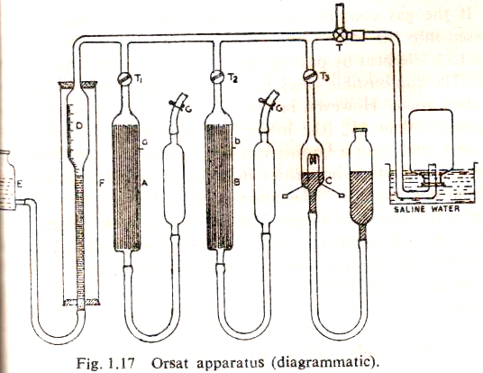
Pipette A: Soln. of 66g of KOH dissolved in 200 cc of distilled water for absorbing CO2
Pipette B: A soln. of alkaline pyrogallol for absorbing O2
Pipettes
Sampling bottle
Combustion pipette
NaCl Soln.

Slide 90
Combustion of CH4 and CO consumes O2 and produces CO2.
In case of CH4 combustion:
CH₄ (1 vol)+2O₂ (2 vol)= CO₂ (1 vol)+ 2H₂O (2 vol condensed)
When 1 vol. of CH4 burns, consumes 2 vols. of O2 and causes a reduction in vol. equal to twice the vol. of CH4.
Also, combustion of 1 vol. of CH4 produces one vol. of CO2.
In case of CO combustion:
2CO (2 vol.) + O2 (1 vol.) = 2 CO2 (2 vol.)
Vol. of CO2 produced after combustion is equal to the vol. of CO.

Slide 91
If the gas contains both CH4 and CO
Let vol. of CH4 = x cc
Vol. of CO = y cc
O2 consumed after combustion = 2x + 1/2y
CO2 produced after consumption: x + y

Slide 92
Haldane Apparatus

Slide 93
This is a more accurate apparatus for analysis of mine air.
It is similar in principle to Orsat Apparatus.
There are two sizes of Haldane Apparatus for different degree of accuracy:
1. Small portable type (burette capacity: 10 cc): graduated to read a min. quantity of 0.01 cc
2. Large laboratory type (burette capacity: 20 cc): graduated to read a min. quantity of 0.001 cc

Slide 94
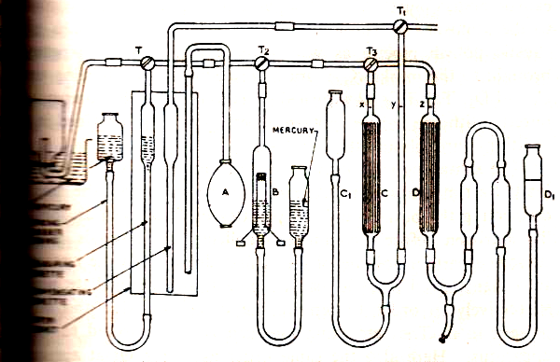
Haldane Apparatus

Slide 95
Constructional Features:
It mainly consists of two burettes
Measuring burette and
Compensating burette: to take into account the variation in atmospheric conditions, viz. temp., press. & humidity.
A water jacket covering both the burettes.
Two pipettes:
  one containing 36% soln. of caustic potash for absorption of CO2
  and the other, a soln. of alkaline pyrogallol (white crystalline powder of trihydroxybenzene, C6H6O3) for absorption of O2.
Surface of pyrogallol soln. is exposed to atmosphere usually covered by a layer of paraffin to prevent oxidation of reagent.

Slide 96
Infra-red Gas Analyzers
These are fairly extensively used today for routine analysis of CH4 and other mine gases.
The method is very quick and has an accuracy of the order 0.1%.
Principle of Working:
It utilizes the principle that a particular gas or liquid absorbs radiation of a particular wave length, e.g. CO2 absorbing radiations of 4.2 µm and CH4 of 7.5 µm.
When an incident beam of this particular wave length passes through a cell containing the gas, it is partly extinguished.

Slide 97
The amount of extinction is governed by Beer’s law
I = I₀ e^{-aLc}
Where
I₀ = intensity of incident beam
I= intensity of transmitted beam
a= absorbency index or molar absorption coefficient
L = optical path or length of the cell
c = molar concentration (kmol m-3)

Slide 98
Constructional Features:
Infra-red spectrometer essentially consists of
A source of infra-red radiation of sufficient range of wave length so as to cover all the gases present in the sample.
A slit and a collimator which produce a narrow beam of parallel rays.
A prism which disperses the beam to its components with various wave lengths.
An adsorption cell for holding the sample and
The receiver which records the intensity of transmitted radiation.

Slide 99
Working
By rotating the prism a beam of a particular wave length can be made to traverse the adsorption cell which should have windows of suitable material that does not absorb the radiation.
For wave lengths between 3-9 µm flourite windows are used.
For wave lengths of 8-16 µm and 15-20 µm respectively, rock salt and sylvine are used.
The prism is also made of same material as the windows.
The receivers can be either bolometers or thermocouples used in conjunction with suitable amplifiers in order to produce measurable voltages.

Slide 100
GAS CHROMATOGRAPH

Slide 101
Gas chromatography is the recent development in the technique for gas analysis.
This method is capable of analyzing mine gases with accuracy from small samples.

Slide 102
Background
Chromatography
It is a physical method of separation in which the components to be separated are distributed between two phases, one of which is stationary (stationary phase) while the other (the mobile phase) moves in a definite direction.
From Greek chroma, color and graphein to write.
A collective term for a set of laboratory techniques for the separation of mixtures.
It involves passing a mixture dissolved in a "mobile phase" through a stationary phase, which separates the analyte to be measured in the mixture based on differential partitioning between the mobile and stationary phases.

Slide 103
Chromatography terms
The analyte: the substance that is to be separated during chromatography.
A bonded phase: a stationary phase that is covalently bonded to the inside wall of the column tubing.
A chromatogram:
  The visual output of the chromatograph.
  Different peaks or patterns on the chromatogram correspond to different components of the separated mixture.

Slide 104
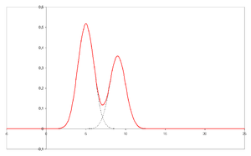
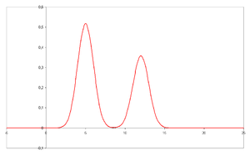
Chromatograms
Plotted on the x-axis: the retention time and
Plotted on the y-axis: a signal corresponding to the response created by the analytes exiting the system.
Signal are obtained by a spectrophotometer, mass spectrometer or a variety of other detectors.
Retention time: the characteristic time taken by a particular analyte to pass through the system (from the column inlet to the detector).

Slide 105
A chromatograph: is equipment that enables a sophisticated separation e.g. gas chromatographic or liquid chromatographic separation.
The mobile phase:
  The phase which moves in a definite direction, may be a liquid or gas (GC).
  It consists of the sample being separated/analyzed and the solvent that moves the sample through the column.
  The mobile phase moves through the chromatography column (the stationary phase) where the sample interacts with the stationary phase and is separated.

Slide 106
The effluent: is the mobile phase leaving the column.
The stationary phase or immobilize phase is the substance which is fixed in place on the inner wall of the column tubing, viz. silica layer in thin layer chromatography.
The sample: is the matter analyzed in chromatography. It may consist of a single component or a mixture of components

Slide 107
Constructional Features
Gas chromatographs essentially comprise
A column containing a stationary phase over which passes a mobile phase of carrier gas from a suitable supply source through a pressure regulator.
The sample to be analyzed is introduced into the carrier gas in an injection chamber immediately before the column.
A suitable detector for recording the concentration of the component gases is provided after the column.

Slide 108
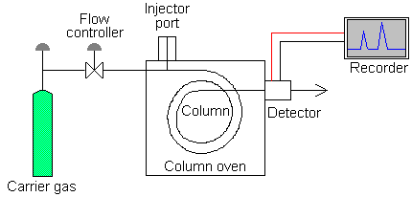
Schematic diagram of a gas chromatograph

Slide 109
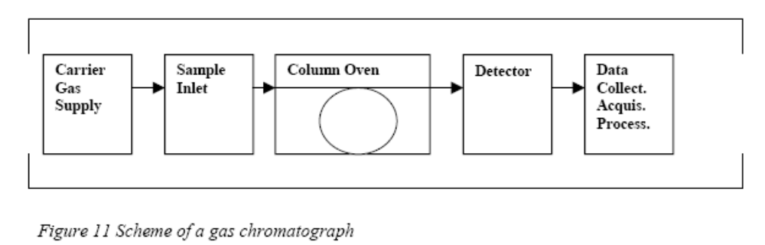
Flow diagram of a gas chromatograph

Slide 110
Generally, a chromatograph is composed of
Carrier gas supply
The sample inlet (injectors)
The column, positioned in a column oven
The detector(s)
A device for data collection, acquisition and processing.

Slide 111
Carrier gas
As mobile phase an inert gas is used, which is delivered by a gas generator, or a gas cylinder.
The most common carrier gases are H2, N2, He.

Slide 112
Choice of the carrier gas
The choice of the carrier gas depends on several demands, e.g.
Chemically inert
High purity: must be of very high purity and should not contain water, oxygen.
  traces of water or oxygen may decompose the stationary phase, which leads to column bleeding and finally destruction of the column.
  special devices for gas purification are installed often prior to the sample inlet.
Should have high thermal conductivity compared to the gas to be detected so that high sensitivity can be obtained with thermal conductivity detectors.

Slide 113
Detector compatibility: For appropriate operation of the detector
Safety reasons: H2 is explosive
Economic: N2 is the cheapest gas
Separation efficiency
Speed: Due to its lowest viscosity, H2 allows to operate the column with the highest mobile phase velocity - and therefore lowest analysis time - at comparable efficiency

Slide 114
Sample injection port
For optimum column efficiency, the sample should not be too large, and should be introduced onto the column as a "plug" of vapour
The most common injection method is where a microsyringe is used to inject sample through a rubber septum into a flash vapouriser port at the head of the column.
The temperature of the sample port is usually about 50°C higher than the boiling point of the least volatile component of the sample.
The injector can be used in one of two modes; split or splitless.

Slide 115
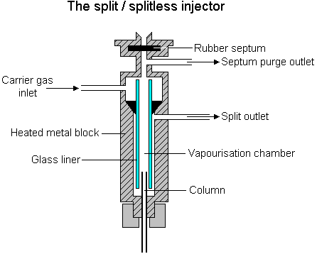

Slide 116
The injector contains a heated chamber containing a glass liner into which the sample is injected through the septum.
The carrier gas enters the chamber and can leave by three routes (when the injector is in split mode).
The sample vapourises to form a mixture of carrier gas, vapourised solvent and vapourised solutes.
A proportion of this mixture passes onto the column, but most exits through the split outlet.
The septum purge outlet prevents septum bleed components from entering the column.

Slide 117
Columns
The column is the most important part of the chromatograph and is responsible for the separation of individual constituents of a gaseous mixture.
It contains as adsorbent which retains different gases for different duration in the column.
For analysis of permanent gases like O2, N2, CO, NO, CH4 etc. in mines, solid absorbents are commonly used.
As a result, the gaseous component which is have the least retention time come out first followed by those with longer retention times thus resulting in the separation of the individual gases.
The detector then senses and records the concentration of these individual gases in the form of Gaussian curves (against time), the height of which or preferably the area under which give, by suitable calibration, the conc. of the gas detected.

Slide 118
There are two general types of column,
  packed and
  capillary (also known as open tubular).
Packed columns contain a finely divided, inert, solid support material (commonly based on diatomaceous earth) coated with liquid stationary phase.
Most packed columns are 1.5 - 10m in length and have an internal diameter of 2 - 4mm.
Capillary columns have an internal diameter of a few tenths of a millimeter.
They can be one of two types; wall-coated open tubular (WCOT) or support-coated open tubular (SCOT). Wall-coated columns consist of a capillary tube whose walls are coated with liquid stationary phase. In support-coated columns, the inner wall of the capillary is lined with a thin layer of support material such as diatomaceous earth, onto which the stationary phase has been adsorbed. SCOT columns are generally less efficient than WCOT columns.
Both types of capillary column are more efficient than packed columns.
In 1979, a new type of WCOT column was devised - the Fused Silica Open Tubular (FSOT) column;

Slide 119
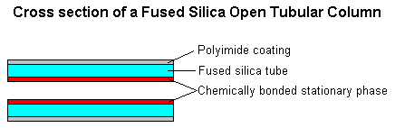
These have much thinner walls than the glass capillary columns, and are given strength by the polyimide coating.
These columns are flexible and can be wound into coils.
They have the advantages of physical strength, flexibility and low reactivity.

Slide 120
Detectors
There are many detectors which can be used in gas chromatography.
These detectors comprise thermal conductivity cells or katharometers having elements of heated wire or thermisters.
As gases of different thermal conductivity pass over the element, it cools to different extent as a result of which the resistance of the element changes.
The change in resistance is recorded through a bridge circuit and amplifier.

Slide 121
Types of Detectors
Different detectors will give different types of selectivity.
A non-selective detector responds to all compounds except the carrier gas,
A selective detector responds to a range of compounds with a common physical or chemical property and
A specific detector responds to a single chemical compound.

Slide 122
For specific gases special types of detectors may be used.
For examples,
  electron-capture detectors are very sensitive for NO2 and halogenated compounds.
  Flame-ionisation detectors can be used for hydrocarbons and
  Microcoulometric detectors for compounds of sulphure.
It is difficult to analyze a condensable gas like CO2 or unsaturated hydrocarbons along with other permanent gases present in mine air with a single column.
In such cases dual columns, one of silica gel for separating CO2 from air (O2 and N2 of air do not get separated here) and the other of molecular sieve for separating the permanent gas components of air such as O2, N2, CH4 etc. are used.

